Slide 1






GAME DEVELOPMENT USING
PYGAME
By MANOGNA, SATHVIKA and NITYA
MENTOR - SANVIT KATREKAR

Slide 2

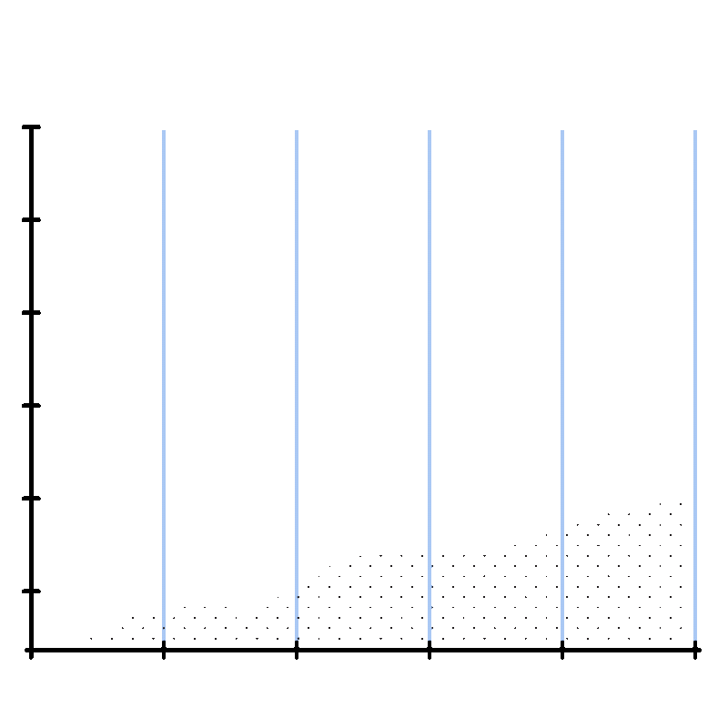
Brainstorming of ideas and games
WHAT WE LEARNT
Projectile motion (making the block jump)
movement using WASD keys and creating boundaries
IDLE / VSC used for coding
Basic movement and key detection (arrow keys)
MarkText used for making notes
Creating a window, concept of event loop

Slide 3
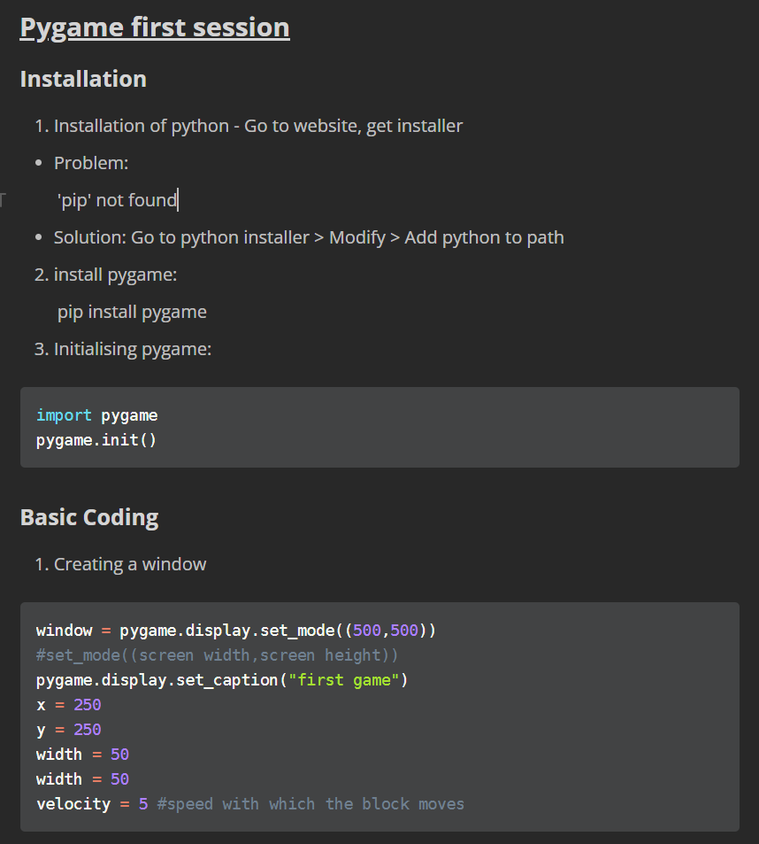
DAY ONE:

Slide 4
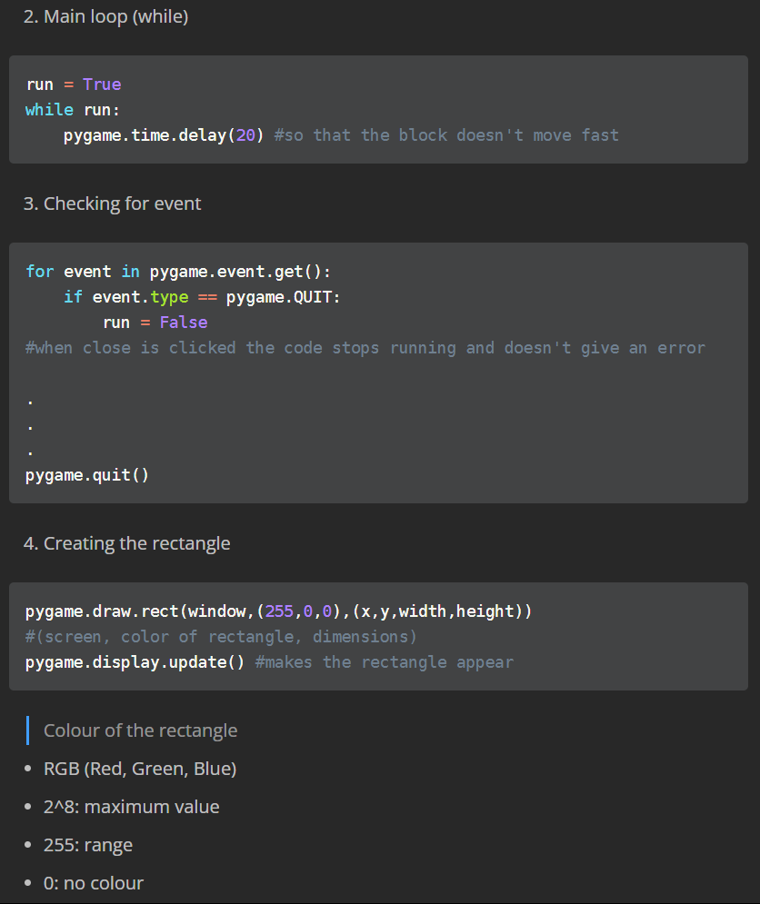
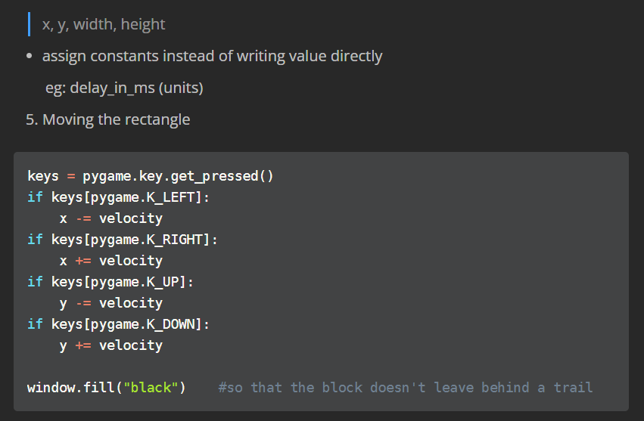
SOME MORE...

Slide 5


Slide 6
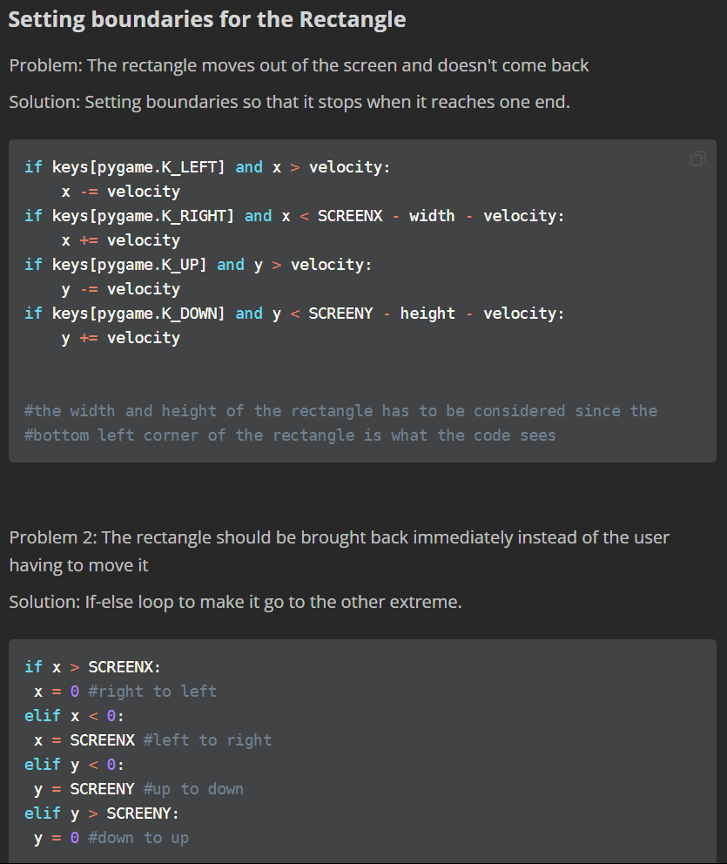
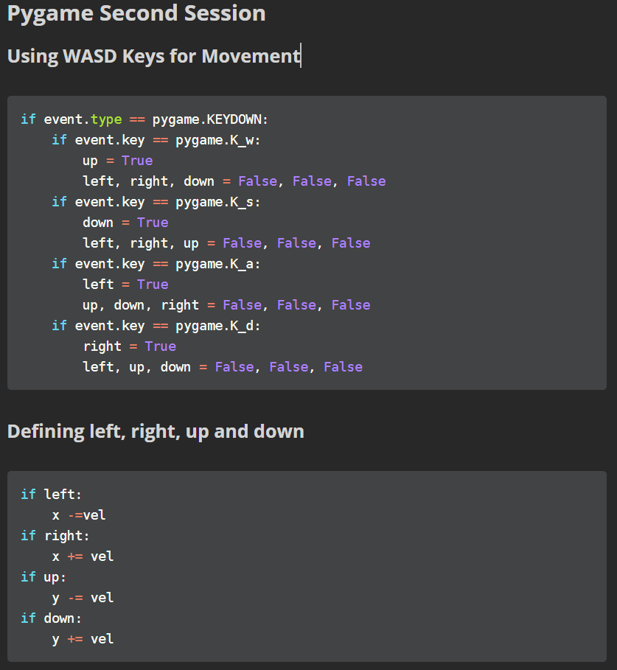
DAY TWO:

Slide 7
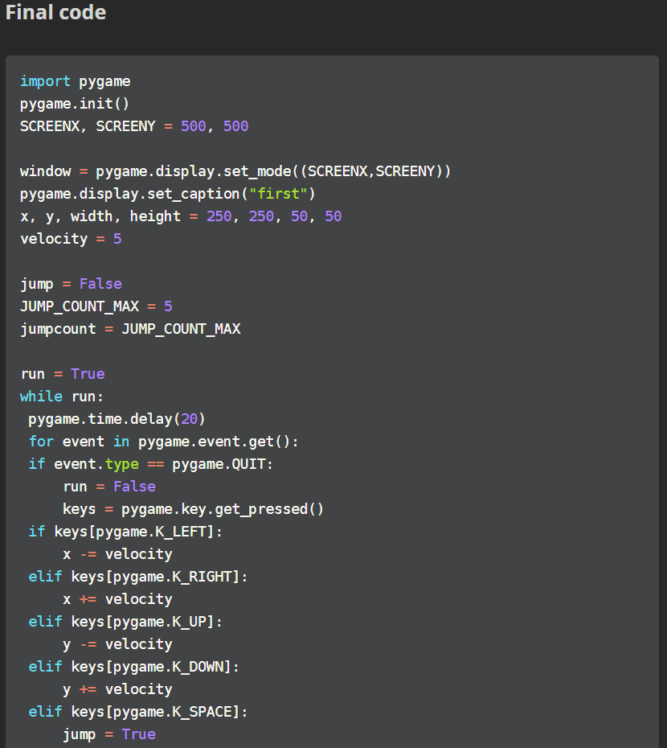
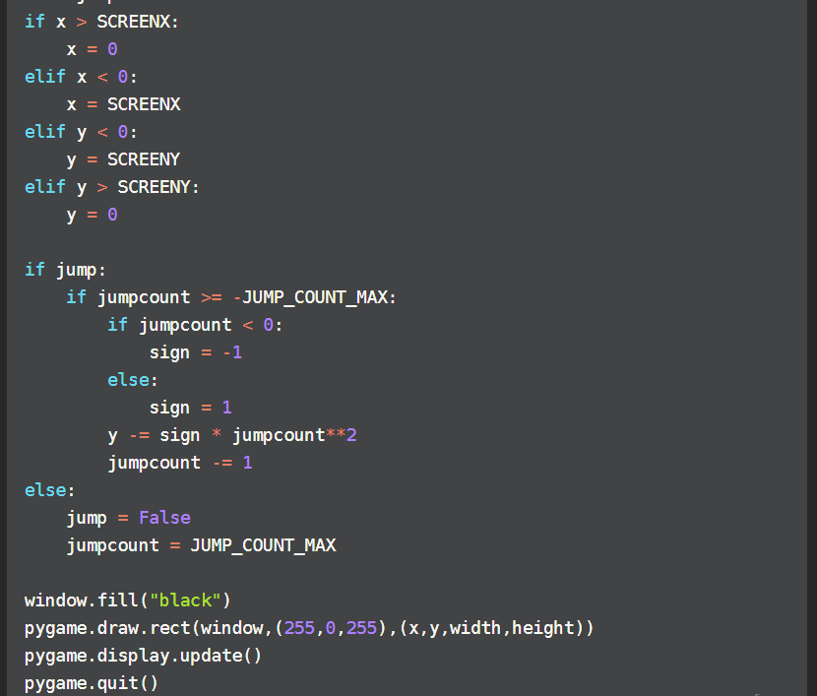

Slide 8


Slide 9
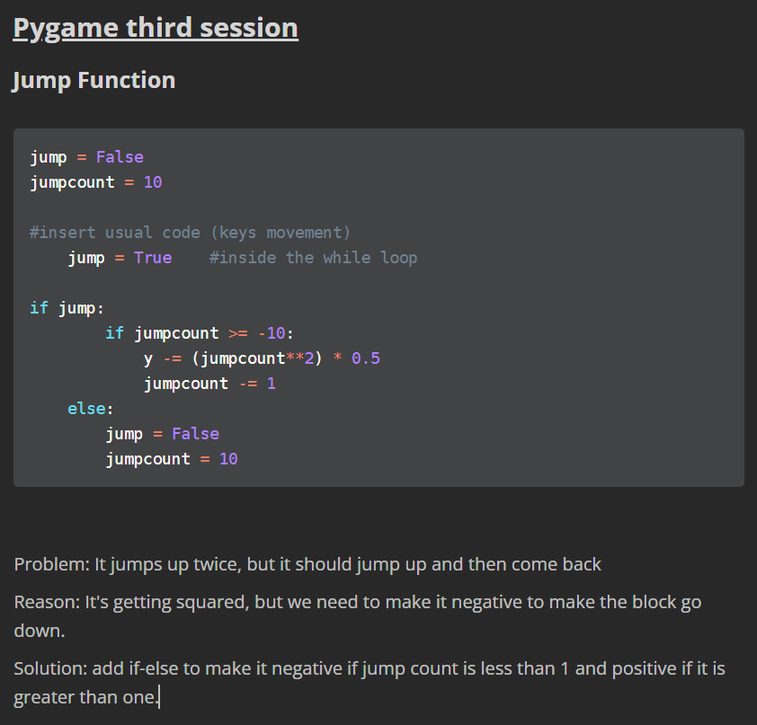
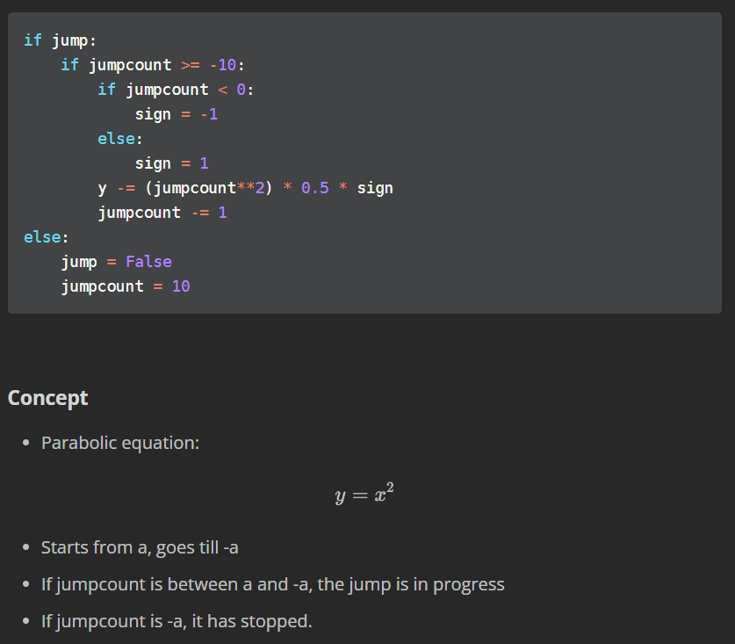
DAY THREE:

Slide 10


Slide 11



BRICK BREAKER GAME

Slide 12

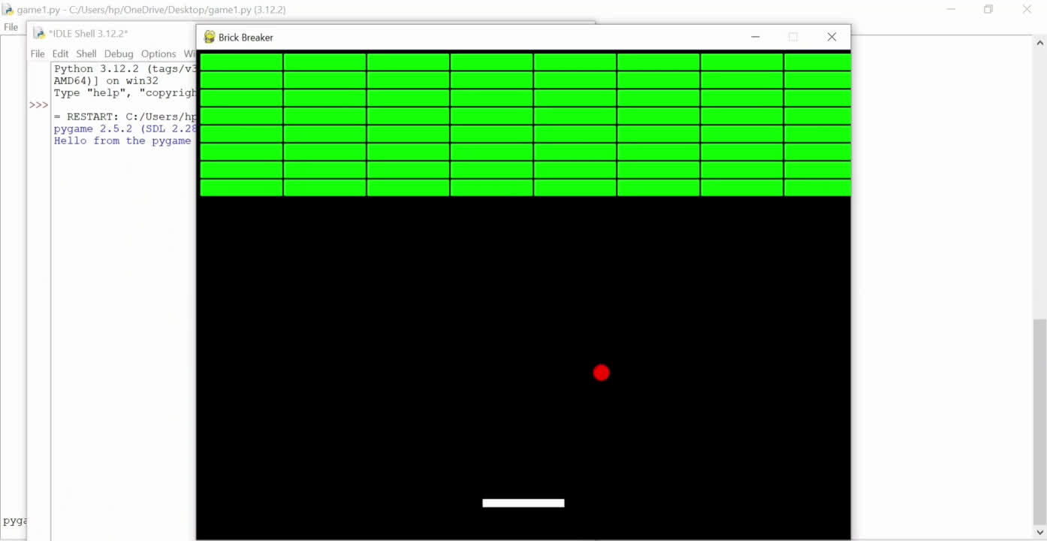
BRICK BREAKER GAME - A DEMO

Slide 13
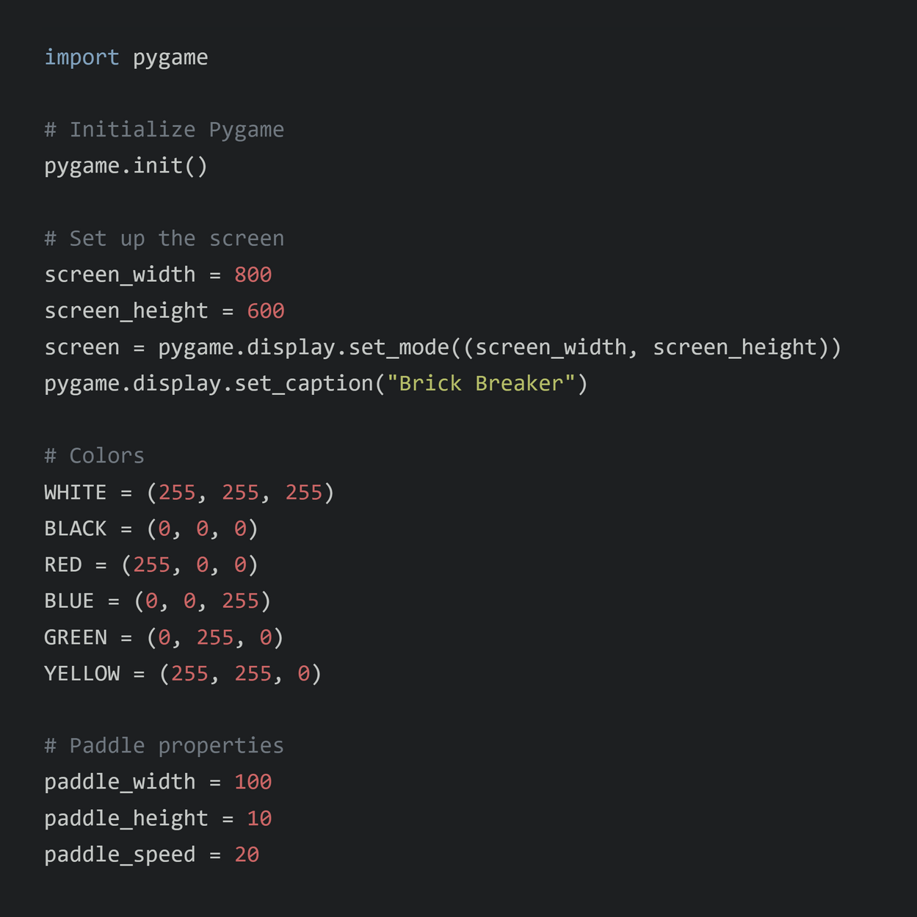
CODE OF THE GAME

Slide 14
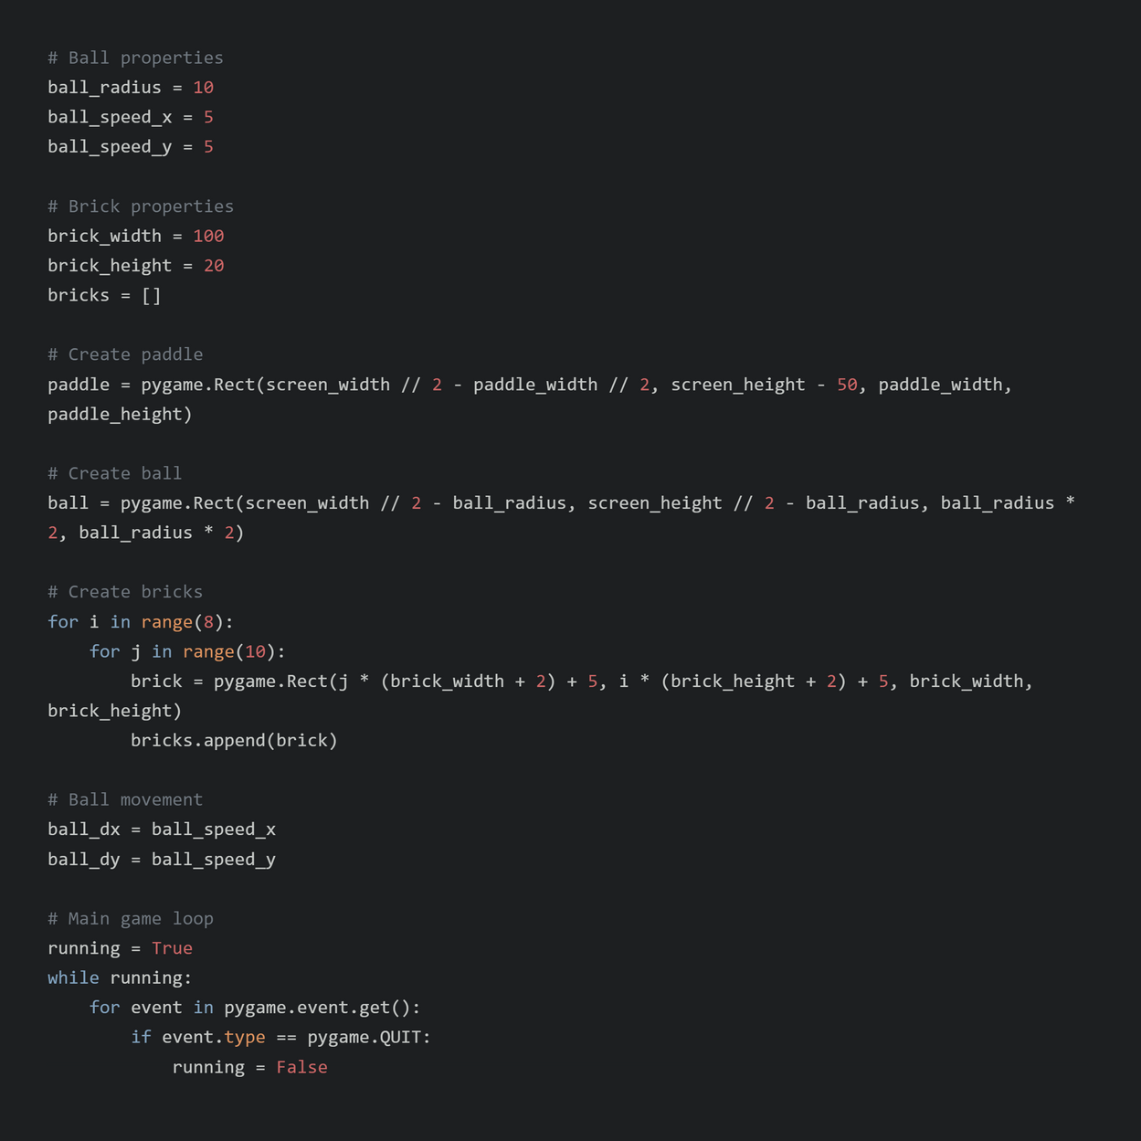
CODE OF THE GAME

Slide 15
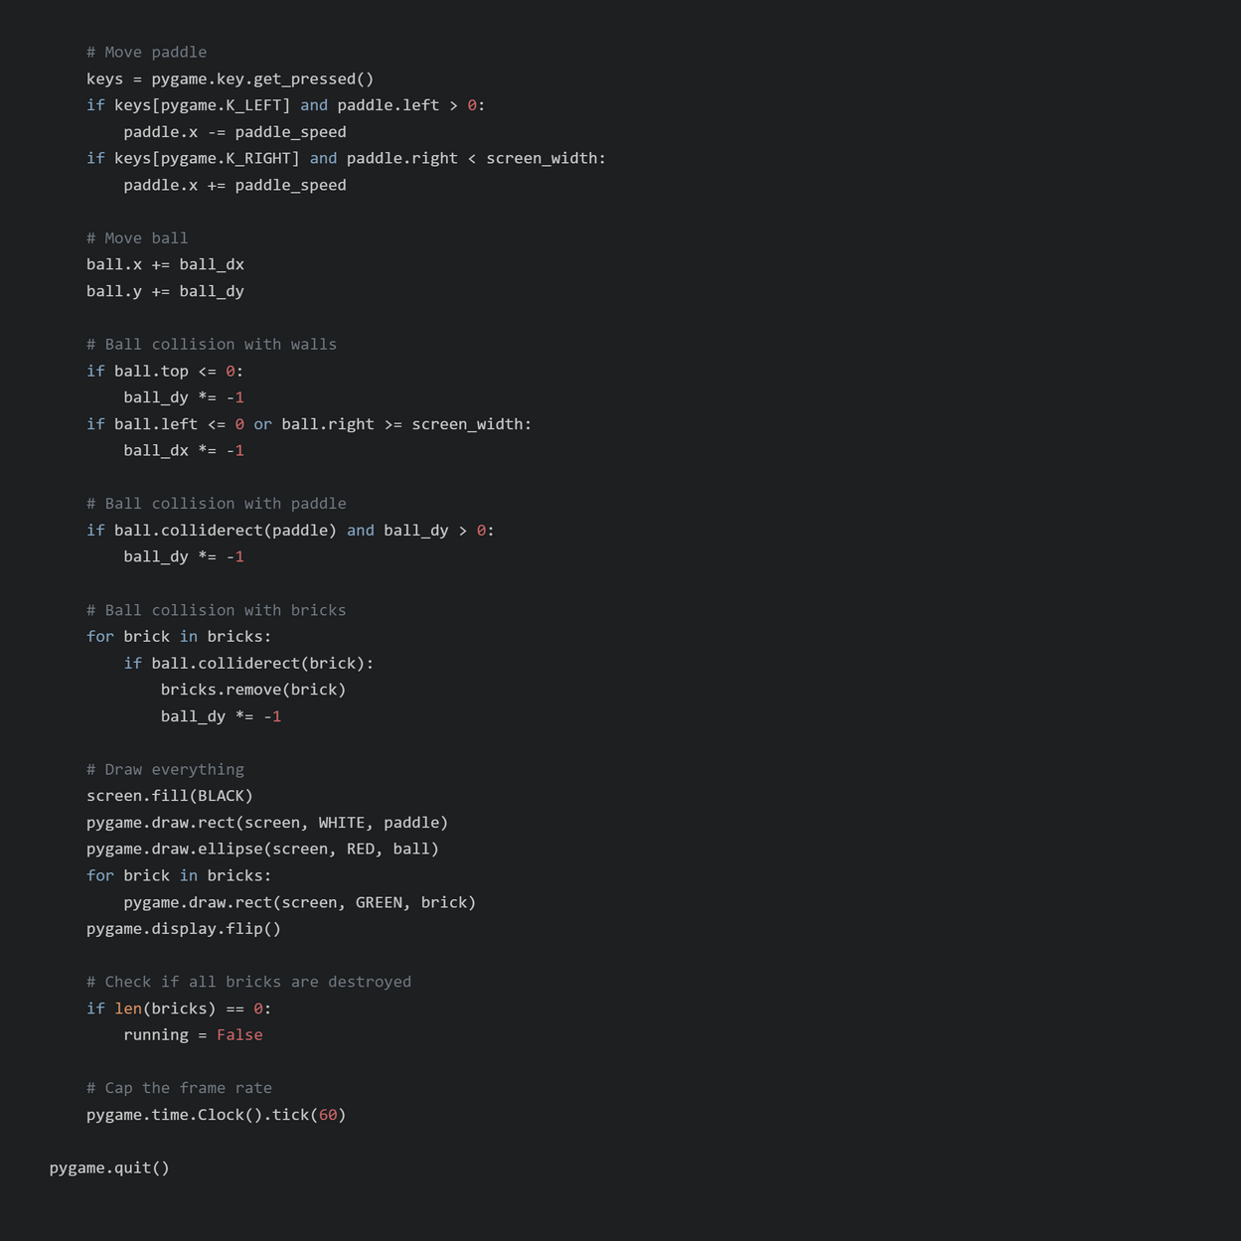
CODE OF THE GAME

